Slide 1


Slide 2


Slide 3


Slide 4

↗

Slide 5

↗

Slide 6
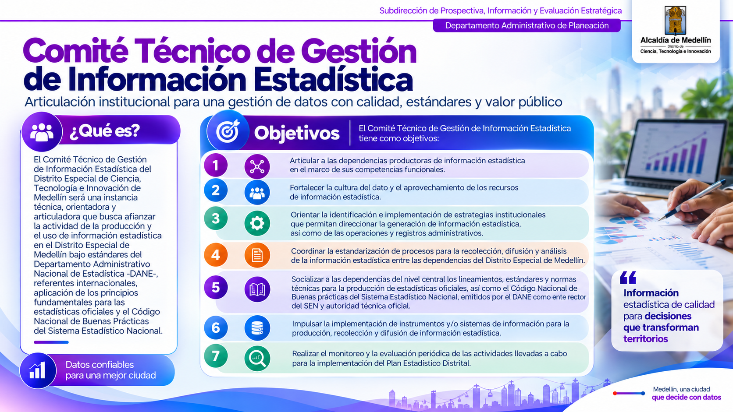

Slide 7
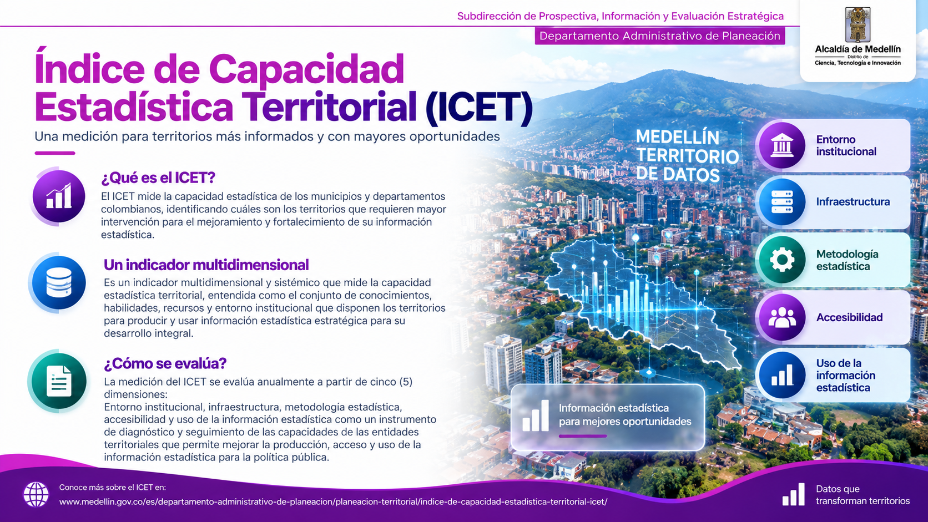

↗

Slide 8

↗

Slide 9


Slide 10
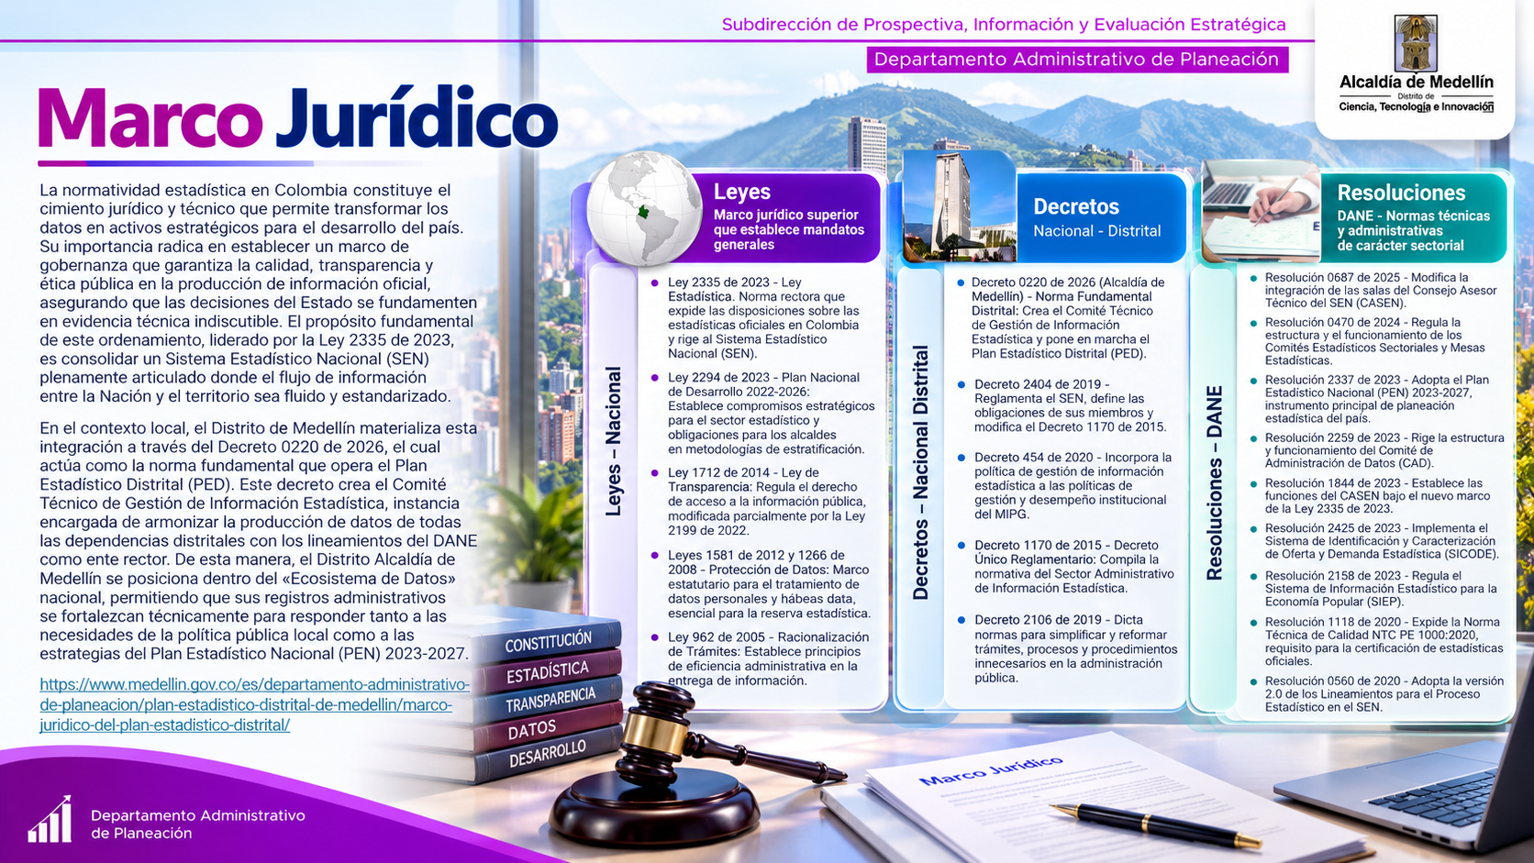
↗

Slide 11
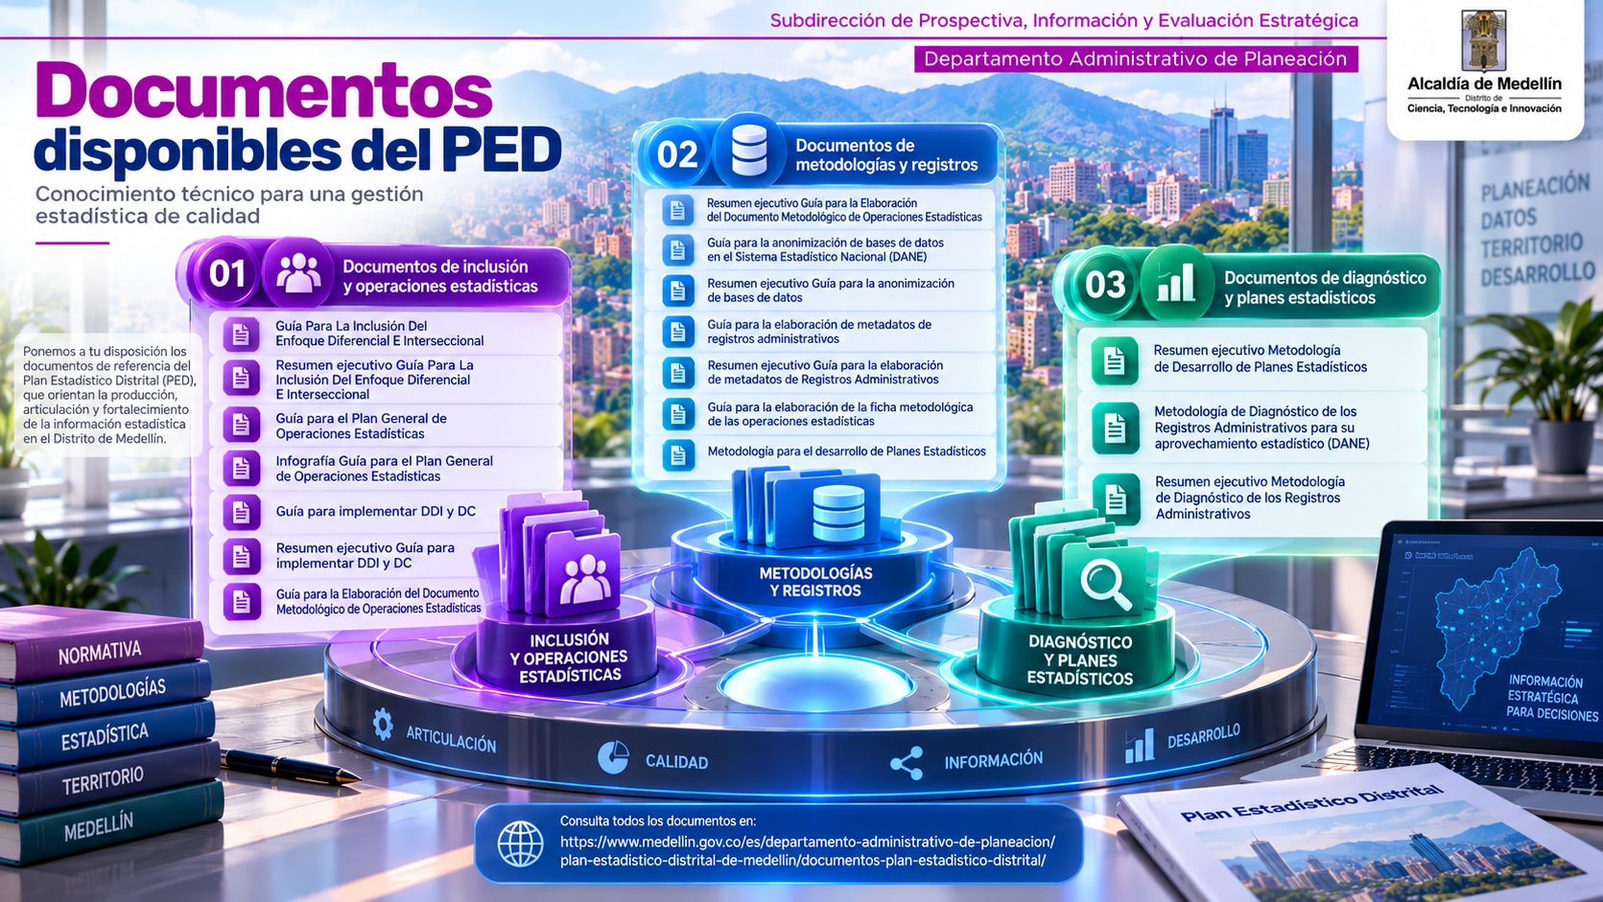
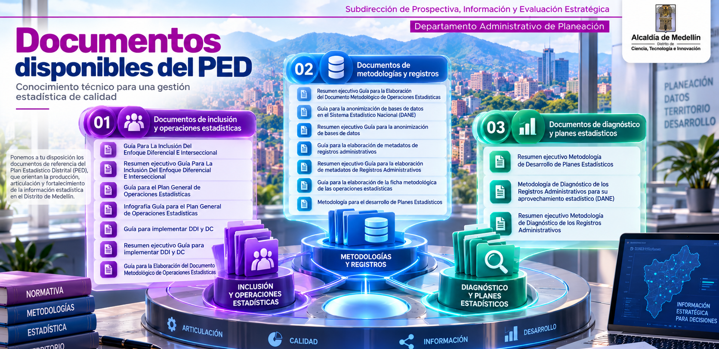
↗

Slide 12


↗

Slide 13


↗

Slide 14

↗

Slide 15


Slide 16
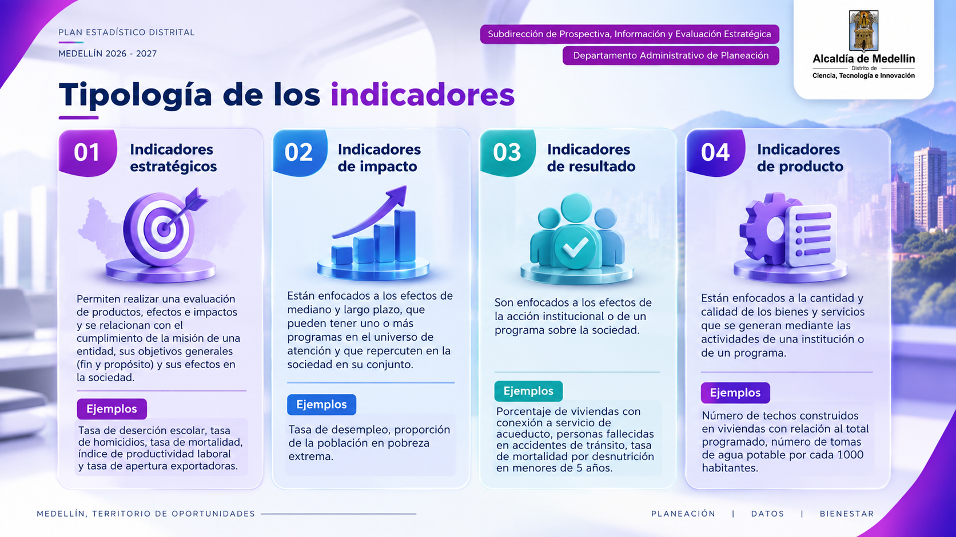

Slide 17
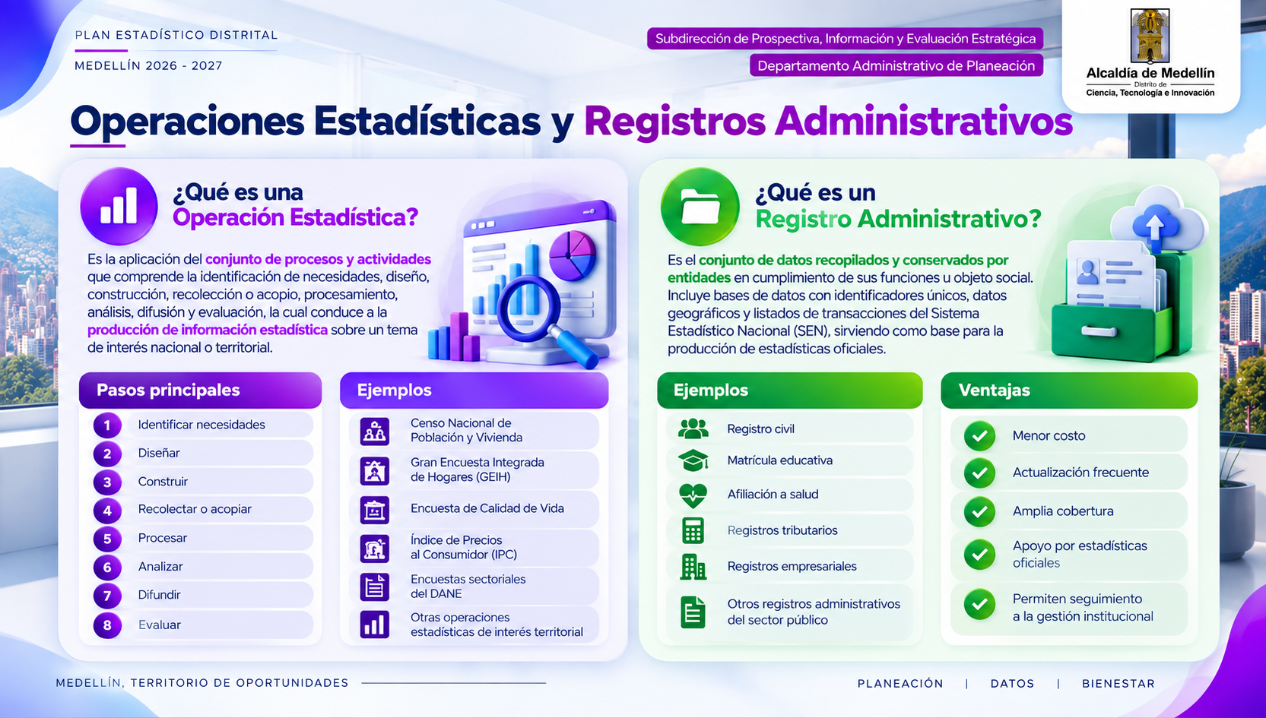

Slide 18


Slide 19


Slide 20


Slide 21
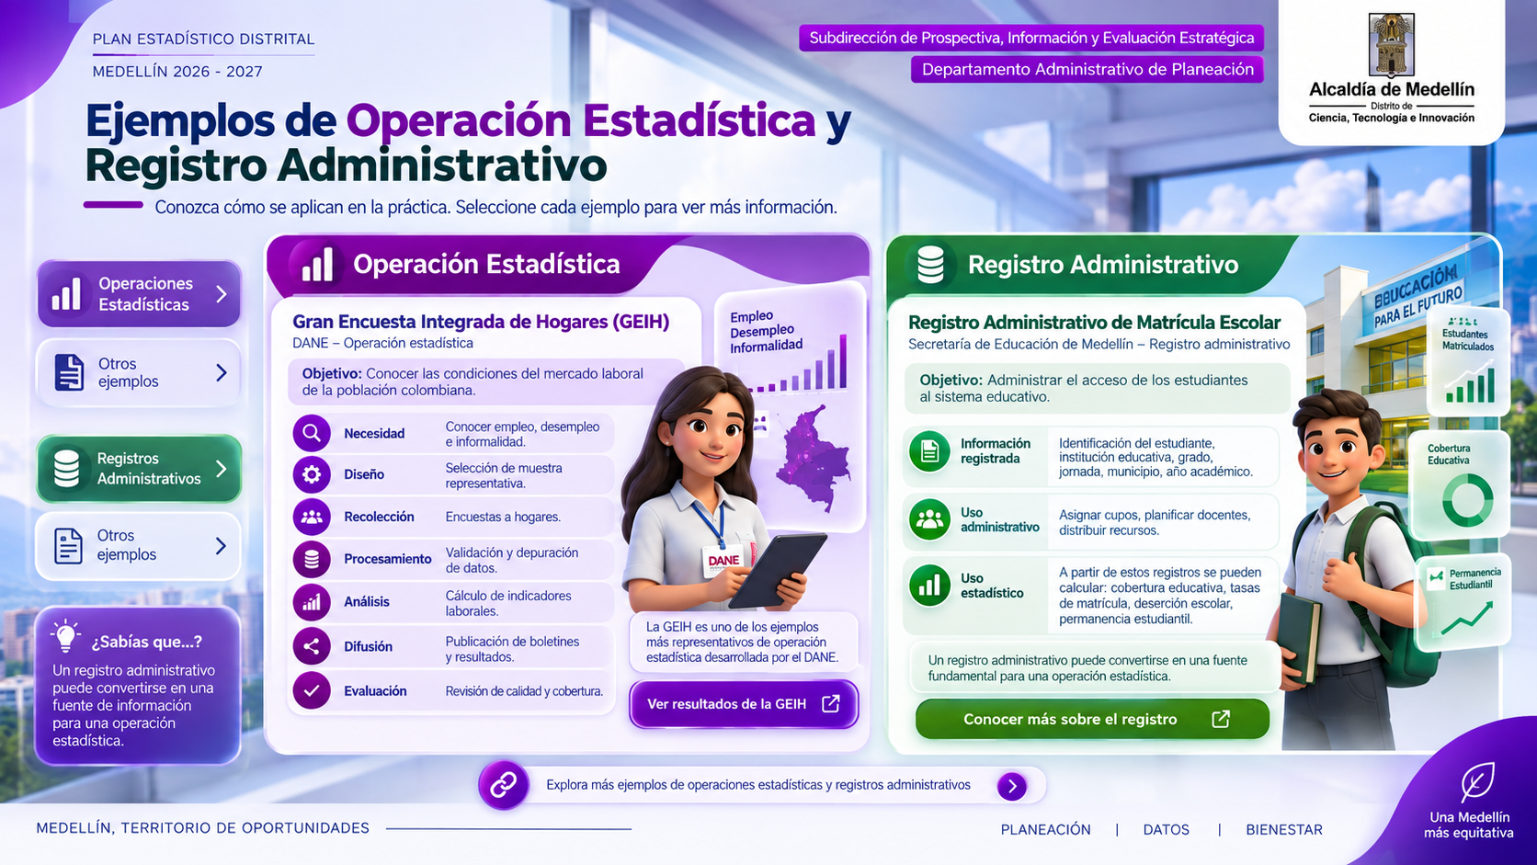

Slide 22

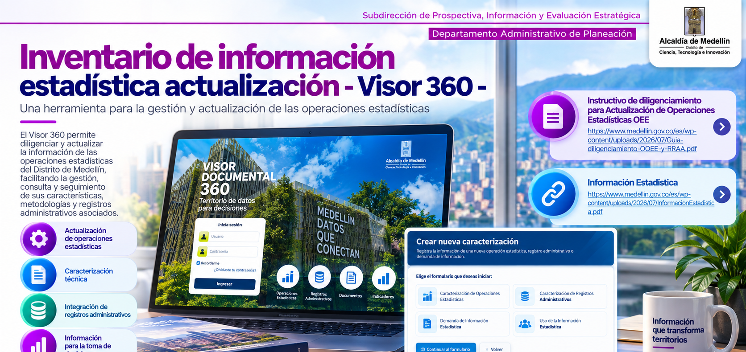
↗
↗
↗

Slide 23


